Slide 1

STUDENT MANAGEMENT SYSTEM
NAME:ANKITHA
STUDENT-ID-21643

Slide 2
INTRODUCTION
A Student Management System (SMS) is a database-driven application designed to efficiently store, manage, and retrieve student-related information in an educational institution. This project implements an SQL-based Student Management System using MySQL Workbench, allowing users to handle student records, course details, faculty assignments, and enrollments systematically.
OBJECTIVE
The primary objective of this project is to digitize and automate student-related data management, reducing the dependency on manual record-keeping. It enables easy data access, efficient querying, and secure storage of student information while ensuring data integrity and consistency.

Slide 3
FEATURES
Student Table – Stores personal details such as name, date of birth, contact information, and address.
Course Table – Maintains records of available courses along with credit allocations.
Faculty Table – Holds faculty details, including department and email addresses.
Enrollment Table – Tracks which students are enrolled in which courses, along with semester details and grades.

Slide 4
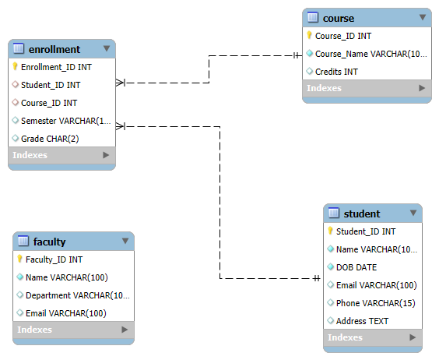
DATA BASE DESIGN(ER DIAGRAM)

Slide 5
CREATE A DATABASE AND STUDENT TABLE
Create Database Studentdb; Use Studentdb;
CREATE TABLE Student (Student_ID INT PRIMARY KEY AUTO_INCREMENT, Name VARCHAR(100) NOT NULL, DOB DATE NOT NULL, Email VARCHAR(100) UNIQUE, Phone VARCHAR(15), Address TEXT);
FIELD | TYPE | NULL | KEY | DEFAULT | EXTRA
Student_ID | INT | NO | PRI | NULL | AUTO_INCREMENT
Name | VARCHAR(100) | NO |  | NULL
DOB | DATE | NO |  | NULL
Email | VARCHAR(100) | YES | UNI | NULL
Phone | VARCHAR(15) | YES |  | NULL
Address | Text | YES |  | NULL

Slide 6
CREATE TABLE OF COURSE
CREATE TABLE Course (Course_ID INT PRIMARY KEY AUTO_INCREMENT, Course_Name VARCHAR(100) NOT NULL, Credits INT CHECK (Credits BETWEEN 1 AND 5));
FEILD | TYPE | NULL | KEY | DEFAULT | EXTRA
Course_ID | INT | NO | PRI | NULL | AUTO_INCREMENT
Course_Name | VARCHAR(100) | NO |  | NULL
Credits | INT | YES |  | NULL

Slide 7
CREATE A TABLE OF FACULTY
CREATE TABLE Faculty (Faculty_ID INT PRIMARY KEY AUTO_INCREMENT, Name VARCHAR(100) NOT NULL, Department VARCHAR(100), Email VARCHAR(100) UNIQUE);
FIELD | TYPE | NULL | KEY | DEFAULT | EXTRA
Faculty_ID | INT | NO | PRI | NULL | AUTO_INCREMENT
Name | VARCHAR(100) | NO |  | NULL
Department | VARCHAR(100) | YES |  | NULL
Email | VARCHAR(100) | YES | UNI | NULL

Slide 8
CREATE A TABLE OF ENROLLMENT
CREATE TABLE Enrollment (Enrollment_ID INT PRIMARY KEY AUTO_INCREMENT, Student_ID INT, Course_ID INT, Semester VARCHAR(10), Grade CHAR(2), FOREIGN KEY (Student_ID) REFERENCES Student(Student_ID) ON DELETE CASCADE, FOREIGN KEY (Course_ID) REFERENCES Course(Course_ID) ON DELETE CASCADE);
FIELD | TYPE | NULL | KEY | DEFAULT | EXTRA
Enrollment_ID | INT | NO | PRI | NULL | AUTO_INCREMENT
Student_ID | INT | YES | MUL | NULL
Course_ID | INT | YES | MUL | NULL
Semester | VARCHAR(10) | YES |  | NULL
Grade | CHAR(2) | YES |  | NULL

Slide 9
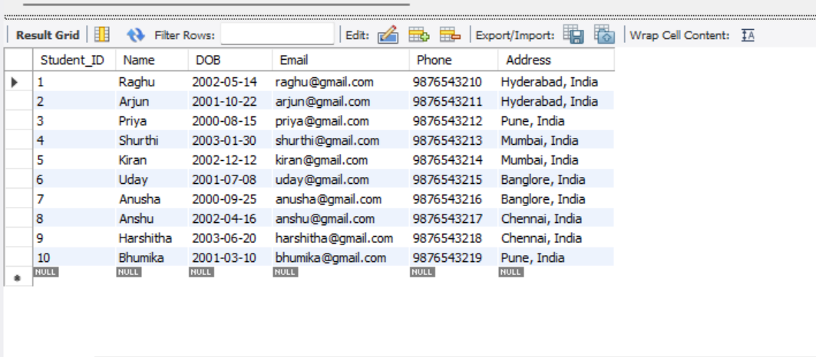
RETRIEVE ALL STUDENTS
SELECT * FROM Student;

Slide 10
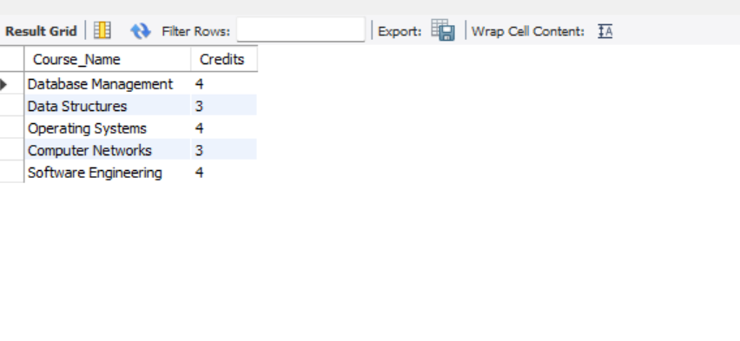
TO GET ALL COURSES WITH CREDITS
SELECT Course_Name, Credits FROM Course;

Slide 11
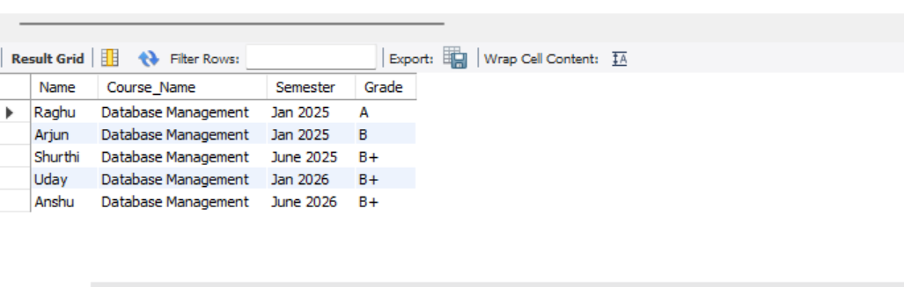
FIND THE STUDENTS ENROLLED IN THE DATABASE MANAGEMENT
SELECT S.Name, C.Course_Name, E.Semester, E.Grade FROM Student SJOIN Enrollment E ON S.Student_ID = E.Student_ID JOIN Course C ON E.Course_ID = C.Course_ID WHERE C.Course_Name = 'Database Management’;

Slide 12
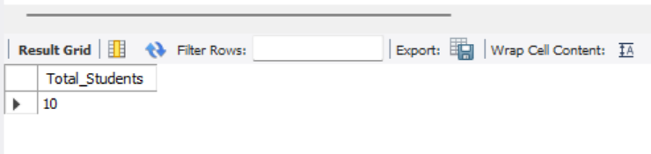
TO COUNT THE NUMBER OF STUDENTS
SELECT COUNT(*) AS Total_Students FROM Student;

Slide 13
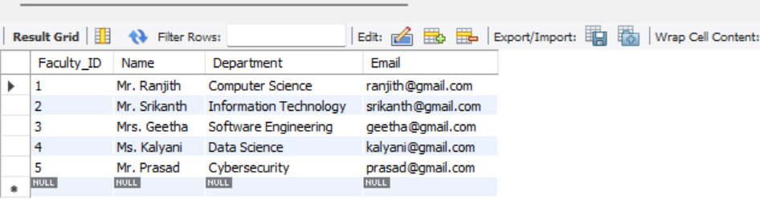
GET THE LIST OF FACULTY MEMBERS
SELECT * FROM Faculty;

Slide 14
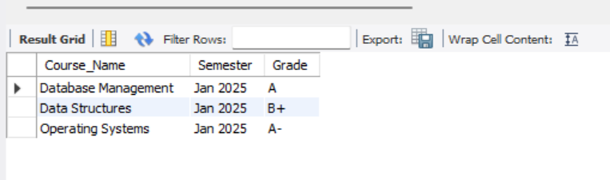
FIND THE COURSES TAKEN BY SPECIFIC STUDENT
SELECT C.Course_Name, E.Semester, E.Grade FROM Course C JOIN Enrollment E ON C.Course_ID = E.Course_ID JOIN Student S ON E.Student_ID = S.Student_ID WHERE S.Name = 'Raghu’;

Slide 15
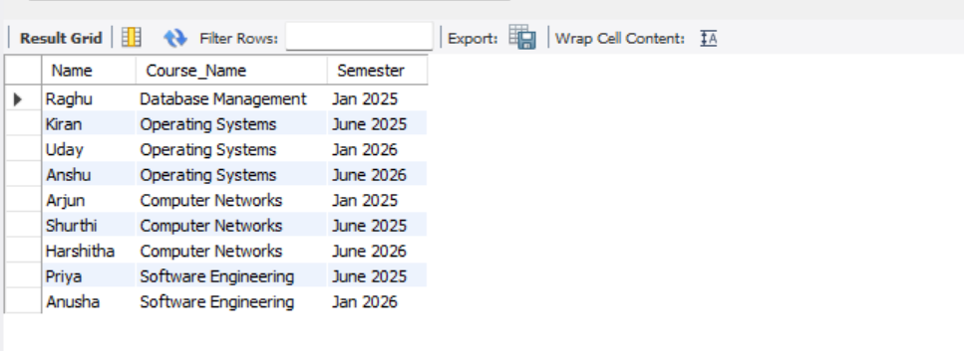
FIND THE STUDENTS WHO SCORED ‘A’ IN ANY COURSE
SELECT S.Name, C.Course_Name, E.Semester FROM Student S JOIN Enrollment E ON S.Student_ID = E.Student_ID JOIN Course C ON E.Course_ID = C.Course_ID WHERE E.Grade = 'A’;

Slide 16
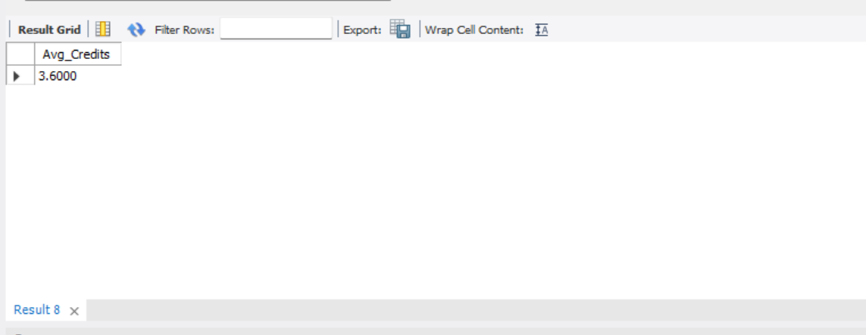
GET THE AVERAGE CREDITS OF THE COURSES
SELECT AVG(Credits) AS Avg_Credits FROM Course;

Slide 17
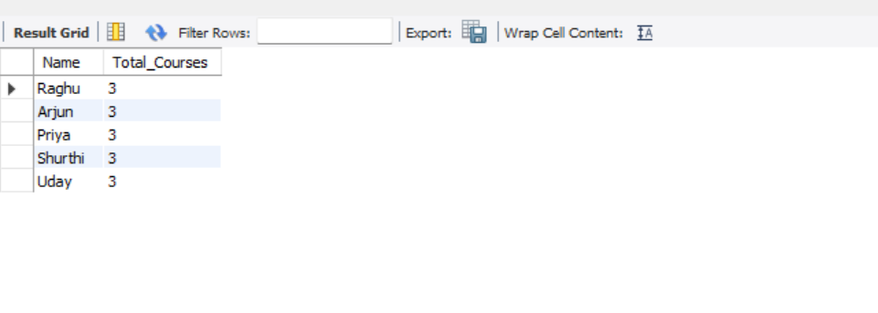
FIND THE STUDENTS WHO ARE ENROLLED IN MORE THAN 2 COURSES
SELECT S.Name, COUNT(E.Course_ID) AS Total_Courses FROM Student S JOIN Enrollment E ON S.Student_ID = E.Student_ID GROUP BY S.Student_ID HAVING Total_Courses > 2;

Slide 18
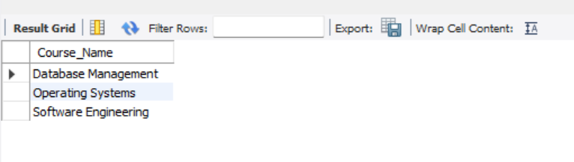
FIND COURSES WITH MORE THAN 3 CREDITS
SELECT Course_Name FROM Course WHERE Credits > 3;

Slide 19
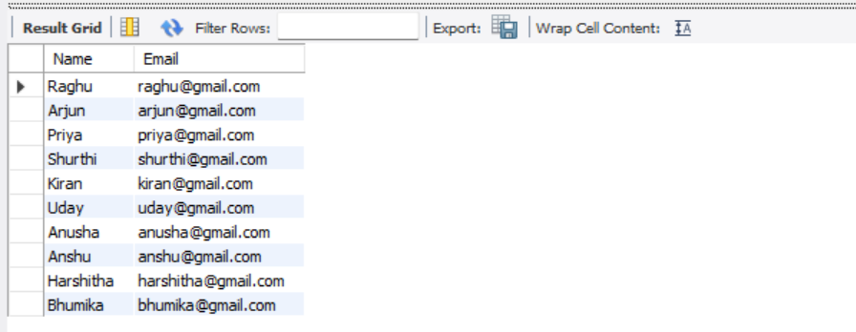
FIND STUDENTS AND THEIR RESPECTIVE EMAILS
SELECT Name, Email FROM Student;

Slide 20
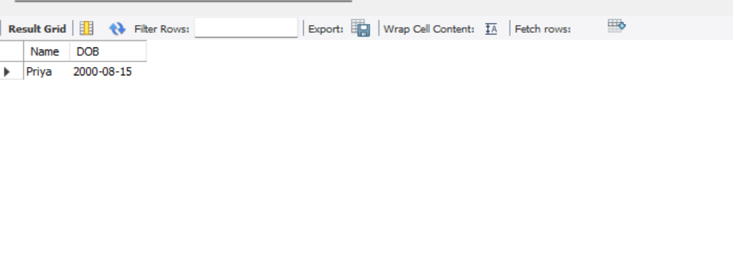
TO FIND THE OLDEST STUDENT
SELECT Name, DOB FROM Student ORDER BY DOB ASC LIMIT 1;

Slide 21
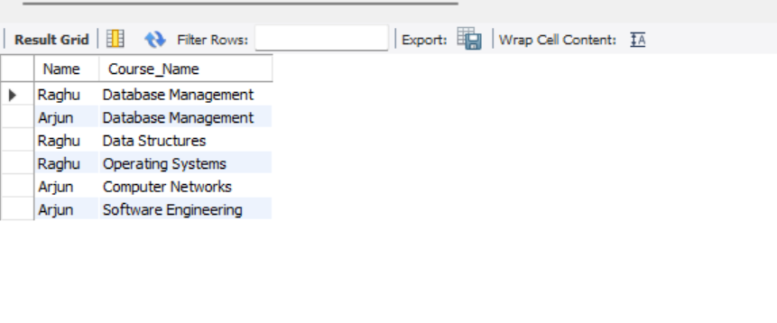
FIND STUDENTS ENROLLED IN JANUARY 2025
SELECT S.Name, C.Course_Name FROM Student S JOIN Enrollment E ON S.Student_ID = E.Student_ID JOIN Course C ON E.Course_ID = C.Course_ID WHERE E.Semester = 'Jan 2025’;

Slide 22
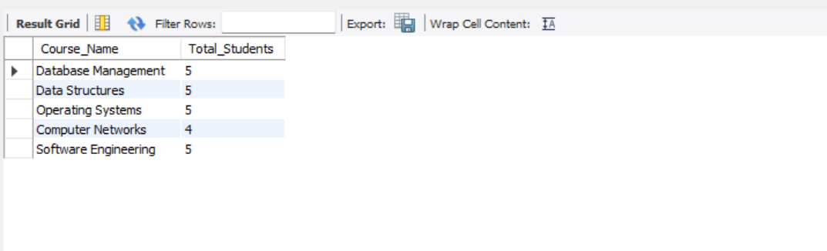
GET NUMBER OF STUDENTS ENROLLED IN EACH COURSE
SELECT C.Course_Name, COUNT(E.Student_ID) AS Total_Students FROM Course C JOIN Enrollment E ON C.Course_ID = E.Course_ID GROUP BY C.Course_ID;

Slide 23
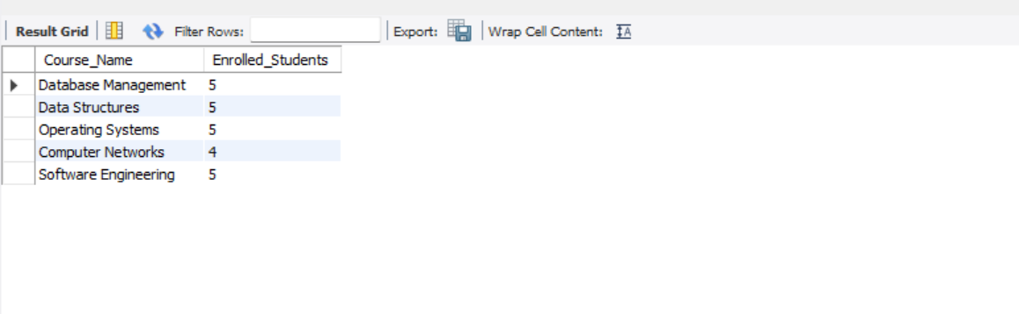
FIND COURSES TAKEN BY MORE THAN 2 STUDENTS
SELECT C.Course_Name, COUNT(E.Student_ID) AS Enrolled_Students FROM Course C JOIN Enrollment E ON C.Course_ID = E.Course_ID GROUP BY C.Course_ID HAVING Enrolled_Students > 2;

Slide 24
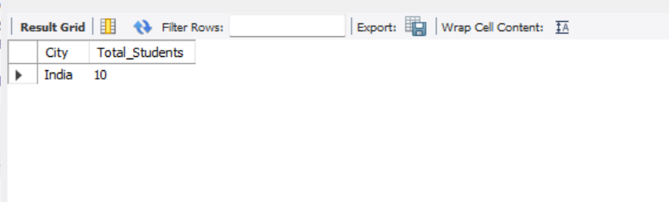
FIND ALL STUDENTS GROUPED BY THEIR CITY
SELECT SUBSTRING_INDEX(Address, ',', -1) AS City, COUNT(*) AS Total_Students FROM Student GROUP BY City;

Slide 25
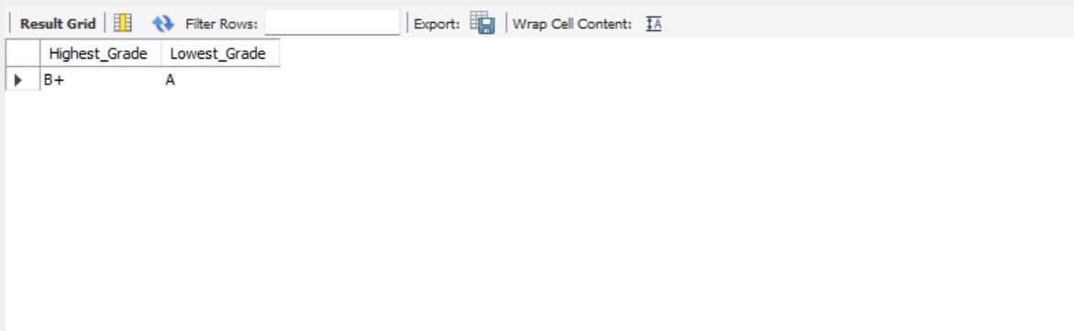
FIND THE HIGHEST AND LOWEST GRADES ASSIGNED
SELECT MAX(Grade) AS Highest_Grade, MIN(Grade) AS Lowest_Grade FROM Enrollment;

Slide 26
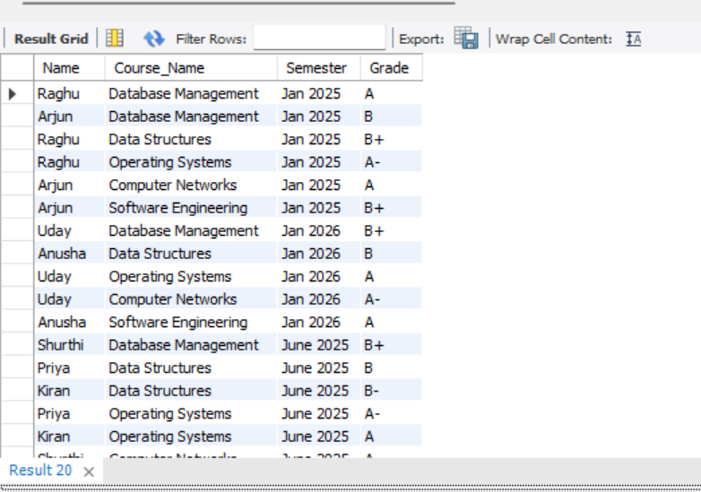
DISPLAY ALL ENROLLEMNTS SORTED BY SEMESTER
SELECT S.Name, C.Course_Name, E.Semester, E.Grade FROM Student S JOIN Enrollment E ON S.Student_ID = E.Student_ID JOIN Course C ON E.Course_ID = C.Course_ID ORDER BY E.Semester ASC;

Slide 27
CONCLUSION
The Student Management System (SMS) is a useful tool for managing student, course, and faculty records efficiently. It helps educational institutions store, update, and retrieve data easily, reducing manual work and errors.With SQL and MySQL Workbench, the system ensures secure, accurate, and well-organized data. It improves accessibility, simplifies enrollment tracking, and supports better decision-making.Overall, this system makes academic administration faster, more efficient, and reliable, benefiting both students and institutions.

Slide 28


